Slide 1
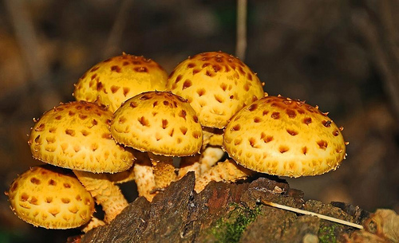
Introduction to Fungi
MD Master Naturalist 2014

Slide 2
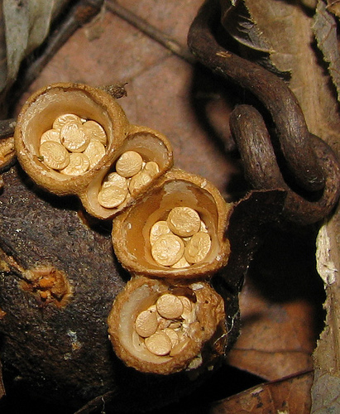
Characteristics of Fungi
Cell wall made of chitin
Heterotrophs and major Decomposers
Body is made of long filaments of hyphae which form a mycelium
Reproduce sexually and asexually
Asexually by spores
Sexually by mating of hyphae filaments
Birds Nest Fungi by Kerry Wixted
Notes:
Chitin is a long-chain polysaccharide, derived from glucose, that serves as the main component of cell walls in fungi AND in the exoskeleton of arthropods (insects, crustaceans, etc.)
Heterotrophs - organisms that are unable to synthesize its own carbon from carbon dioxide (like green plants) or other inorganic compounds. They are not capable of producing their own food; they obtain their energy requirements by feeding on organic matter or another organism. Heterotrophs are the consumers in the food chain.
Hyphae (sing. Hypha) – from the Greek, meaning “web”
Mycelium (used as both singular and plural, although mycelia is also correct) – main form of vegetative growth; principle organ for nutrient and water absorption and transport
The above ground portion of a fungus is the fruiting body (spore-bearing part) for asexual reproduction. More often than not, what is below ground is significantly larger than the above ground mushroom.
The largest single organism in the world is a fungus. The “2,400-acre (9.7 km2) site in eastern Oregon had a contiguous growth of mycelium before logging roads cut through it. Estimated at 1,665 football fields in size and 2,200 years old, this one fungus has killed the forest above it several times over, and in so doing has built deeper soil layers that allow the growth of ever-larger stands of trees. Mushroom-forming forest fungi are unique in that their mycelial mats can achieve such massive proportions.”
—Paul Stamets, Mycelium Running

Slide 3
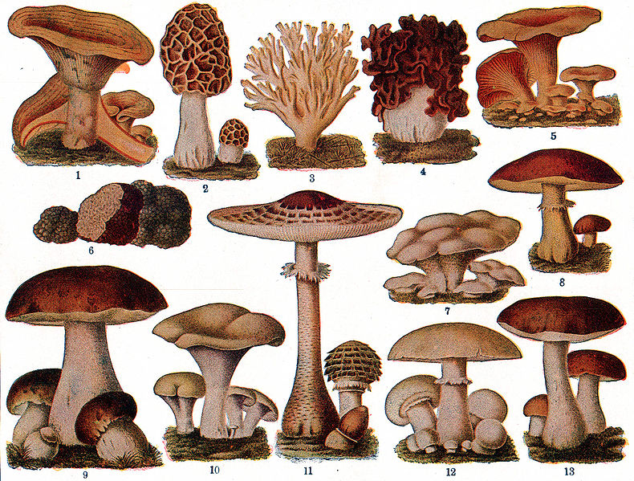
Ecosystem Roles of Fungi
Recycling
Mycorrhizae
Food
Medicine
Biocontrol
Plant & Animal Diseases
Notes:
Recycling Fungi, together with bacteria, are responsible for most of the recycling which returns dead material to the soil in a form which can be reused. Without fungi, these recycling activities would be seriously reduced. We would effectively be lost under piles many meters thick, of dead plant and animal remains.
Mycorrhizae and plant growth Fungi are vitally important for the good growth of most plants, including crops, through the development of mycorrhizal associations. Mycorrhizal associations are the (usually) mutualistic symbiotic relationship between the colonizing mycelium of a fungus and the roots of a vascular plant. The fungus draws carbohydrates from the plant’s leaves and in return, increases the plant root’s absorption capacity for water and mineral nutrients, especially phosphorus. As plants are at the base of most food chains, if their growth was limited, all animal life, including human, would be reduced through starvation. Almost 90% of all land plants depend on mycorrhizae!
Food Fungi are also important directly as food for humans. Many mushrooms are edible and different species are cultivated for sale worldwide. While this is a very small proportion of the actual food that we eat, fungi are also widely used in the production of many foods and drinks. These include cheeses, beer and wine, bread, some cakes, and some soya bean products. While a great many wild fungi are edible, it can be difficult to identify them correctly. Some mushrooms are deadly if they are eaten in any form. Some are toxic if eaten uncooked but are fine if cooked. Fungi with names such as 'Destroying Angel' and 'Death Cap' give us some indication that it would not be a terribly good idea to eat them! Collecting wild mushrooms to eat is a popular activity; mushroom hunters can be very protective of “their” patches. It is always wise to be sure that what you have collected is edible and not a poisonous look-a-like. Even professional mycologists have been fooled. Check in the list of resources at the end of this slide show for safety measures.
Of the thousands of mushrooms found in North America, about 5 percent are edible. About 5 percent are poisonous, too. And the rest just aren’t fit to be eaten. The old folklore about how to tell if a mushroom is poisonous – such as whether it tarnishes silverware or turns blue when bruised – is wrong. And so is a lot of what is on Wikipedia. Better safe than dead (or the victim of an allergic reaction.)
Medicines Penicillin, perhaps the most famous of all antibiotic drugs, is derived from a common fungus called Penicillium. Many other fungi also produce antibiotic substances, which are now widely used to control diseases in human and animal populations. The discovery of antibiotics revolutionized health care worldwide. Some fungi which parasitize caterpillars have also been traditionally used as medicines. The Chinese have used a particular caterpillar fungus as a tonic for hundreds of years. Certain chemical compounds isolated from the fungus may prove to be useful treatments for certain types of cancer. A fungus which parasitizes Rye crops causes a disease known as Ergot. The fungus can occur on a variety of grasses. It produces small hard structures, known as sclerotia. These sclerotia can cause poisoning in humans and animals which have eaten infected material. (Ergot poisoning may be the ultimate cause of the community madness that resulted in the Salem witch trials.) However, these same sclerotia are also the source of a powerful and important drug which has uses in childbirth.
Biocontrol Fungi which parasitize insects, such as the Chinese caterpillar fungus, can be extremely useful for controlling insect pests of crops. The spores of the fungi are sprayed on the crop pests. Fungi have been used to control Colorado potato beetles, which can devastate potato crops. Spittlebugs, leaf hoppers and citrus rust mites are some of the other insect pests which have been controlled using fungi. This method is generally cheaper and less damaging to the environment than using chemical pesticides.
Plant Diseases Fungal parasites may be useful in biocontrol, but they can also have enormous negative consequences for crop production. Some fungi are parasites of plants. Most of our common crop plants are susceptible to fungal attack of one kind or another. Spore production and dispersal is enormously efficient in fungi; and plants of the same species crowded together in fields are ripe for attack. Fungal diseases can on occasion result in the loss of entire crops if they are not treated with antifungal agents. Other plant diseases include Chestnut Blight and Dutch Elm Disease.
Animal Disease Fungi can also parasitize domestic animals causing diseases, but this is not usually a major economic problem. A wide range of fungi also live on and in humans, but most coexist harmlessly. Athletes foot and Candida infections are examples of human fungal infections.

Slide 4
M.M. Kyde, Ph.D.

Slide 5
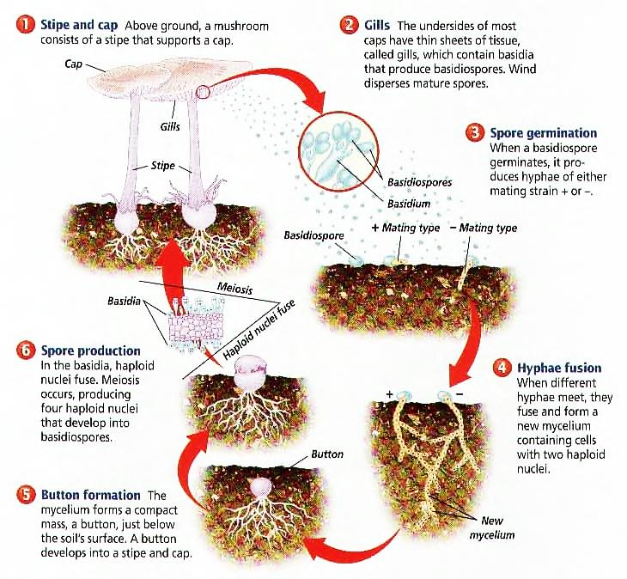
Lifecycle of Basidiomycete Fungi
Notes:
The (macro) fungi typically can be divided into two broad groups, ascomycetes and basidiomycetes, depending on how their sexual spores are formed. In ascomycetes, the spores are produced within microscopic cells called asci. The asci vary in shape from cylindric to spherical. Commonly, each ascus holds eight spores - but there are species with just one spore per ascus and others with over a hundred spores per ascus. In basidiomycetes, the spores develop on projections that grow out from microscopic cells called basidia, rather than being enveloped within cells. In most cases, the basidia are elongated and club-like, though there is variation in shape. Commonly, each basidium has four projections and four spores - but some species may have just one projection and spore per basidium and others up to eight. In most basidiomycetes the basidia have no dividing walls (or septa), but in a small number of genera the basidia are septate. The projections from the basidia are called sterigmata (singular: sterigma). The lifecycle of basidiomycete is shown above.

Slide 6
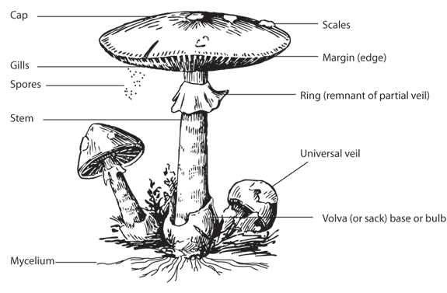
Parts of a Mushroom
Notes:
Note: Not all mushrooms have all of these structures

Slide 7
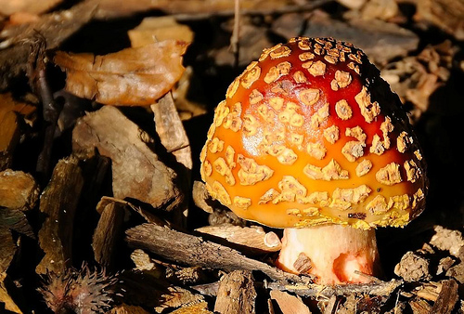
Field Characters for Identification
Color of spores in deposit – make a spore print.
Shape and size of cap (pileus) and appearance of its margin
Color of cap and cap flesh, presence of scales or other markings
Texture of cap – sticky, dry, powdery, scaly, slimy?
Stem (stipe) – dimensions, color, markings, shape, presence or absence of a ring (annulus), position of annulus
Spore bearing surface (fertile surface) – gills or pores, color, shape size, gill attachment, gill spacing
Color changes – turns blue, red, brown, yellow
Odor and taste – odor may be very distinctive, tasting unwise unless knowledgeable
Habitat – host or associated plant, grass, wood, leaves, twigs, moss, etc. Is the host alive or dead?
Growth pattern – single, scattered, gregarious, cespitose
Month or season – indicative for some
Photo by: Richard Orr

Slide 8
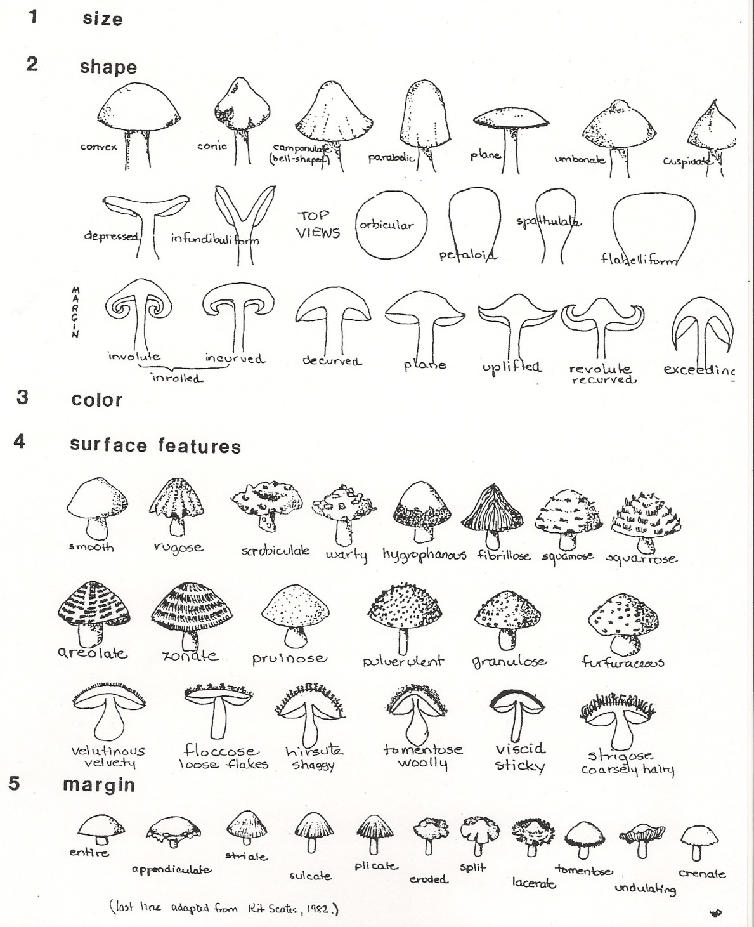
Macroscopic Dissection of a Cap
M.M. Kyde, Ph.D.

Slide 9
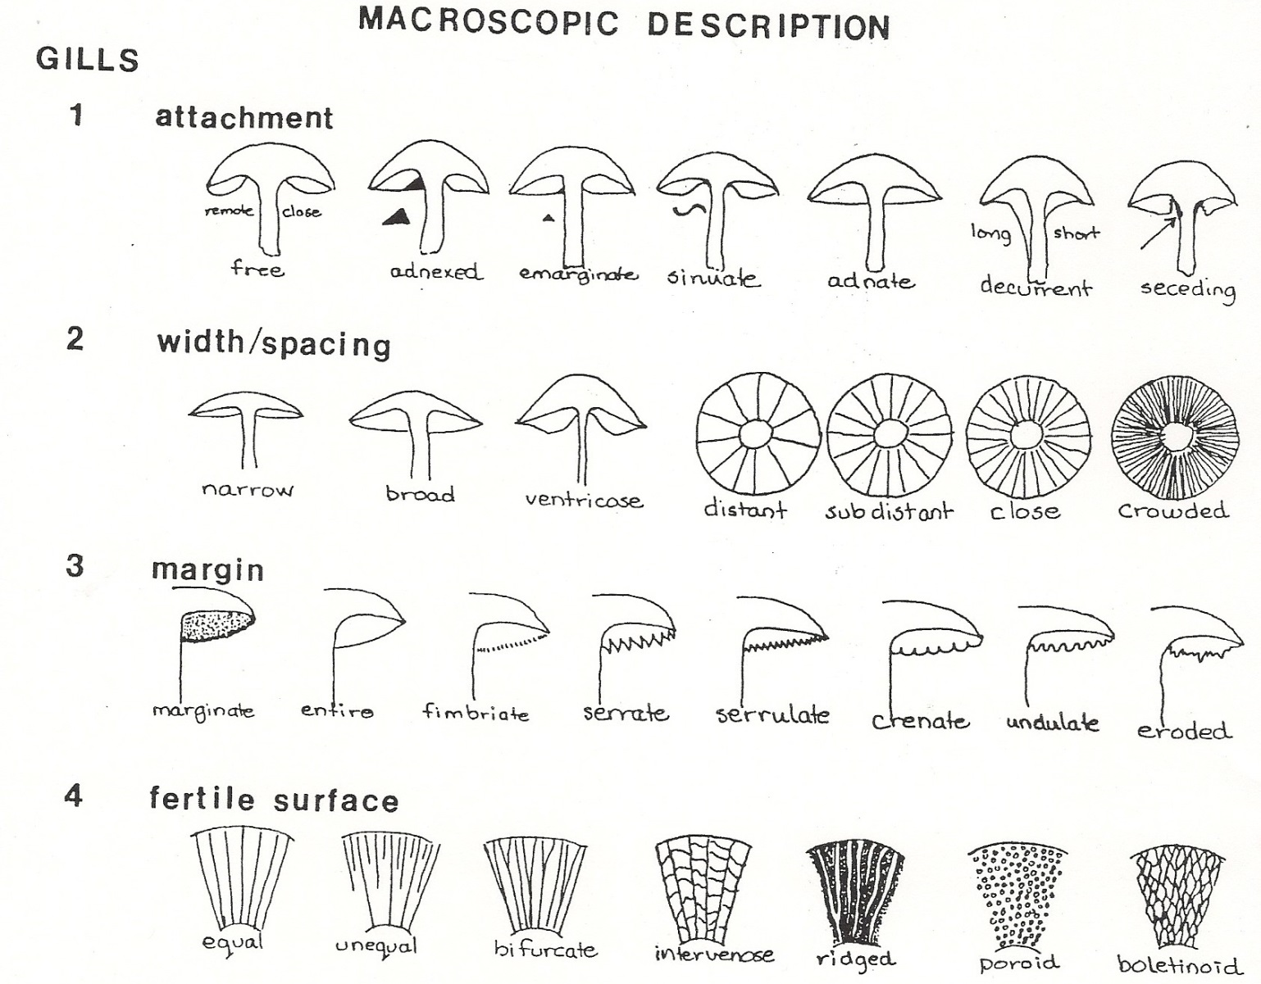
Macroscopic Dissection of Gills
M.M. Kyde, Ph.D.

Slide 10
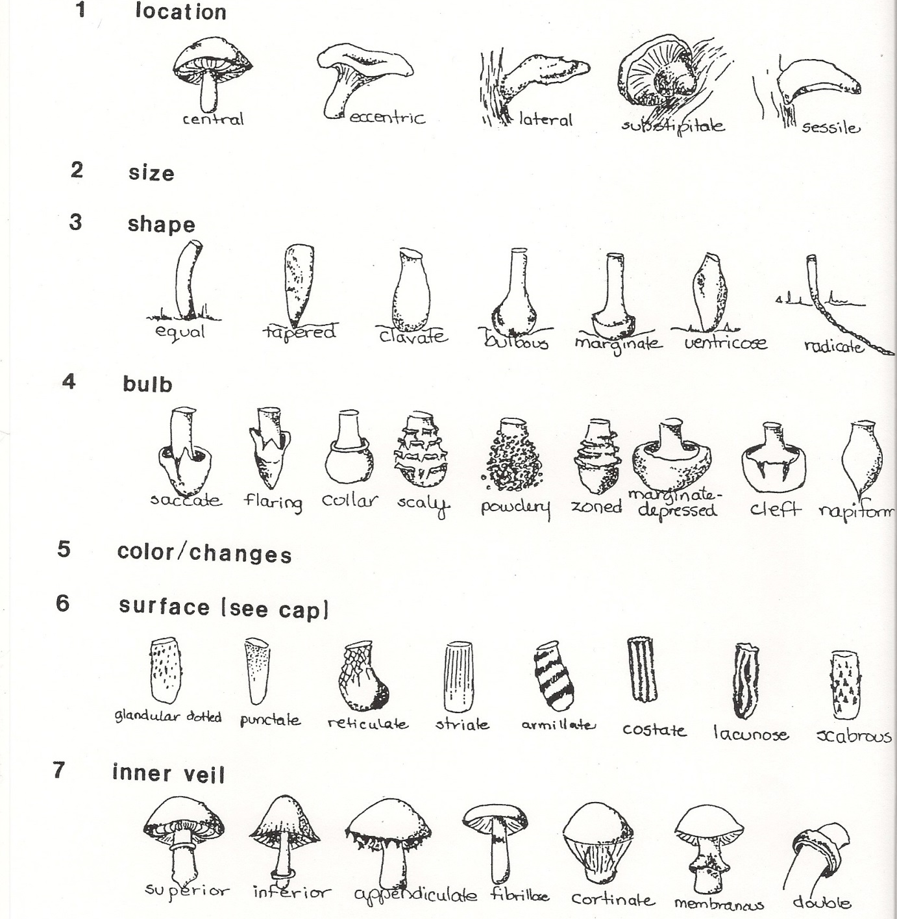
Macroscopic Dissection of a Stipe
M.M. Kyde, Ph.D.

Slide 11
Mushroom Habits
M.M. Kyde, Ph.D.

Slide 12
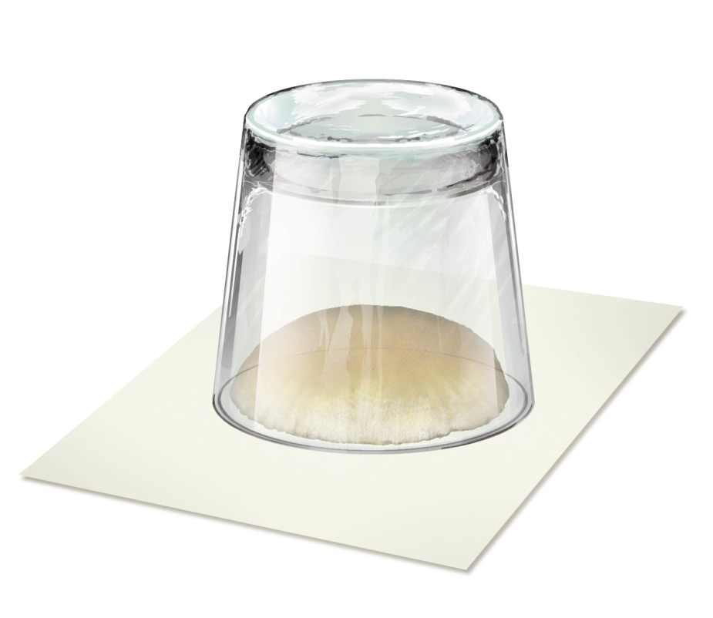
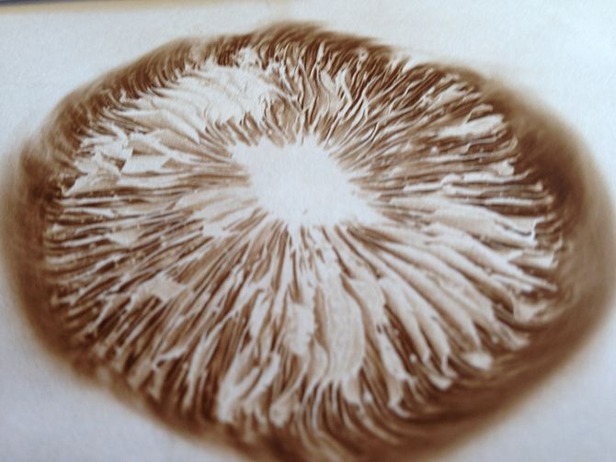
How to Make a Spore Print
Need: mature mushroom
Remove stem & place cap with gills or pores downward on paper or glass. Spores are different colors; try different colored paper
Place cup or glass over mushroom
Check occasionally for spore deposit

Slide 13
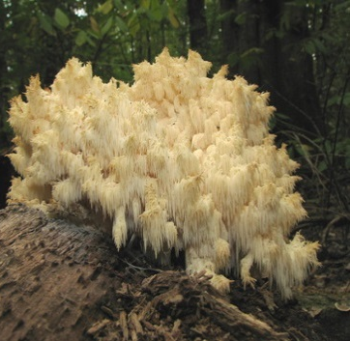
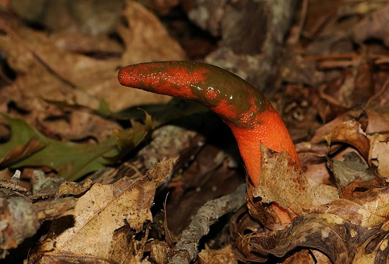
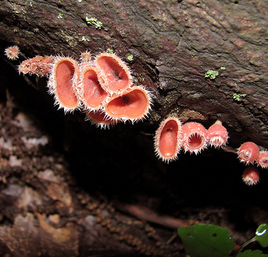
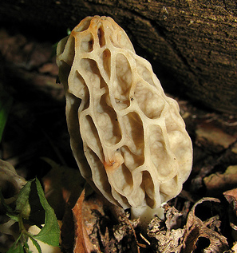
Common Mushroom Types
Gilled Mushrooms
Boletes & Stalked Polyphores
Bracket Fungi
Tooth Fungi
Club Fungi
Coral Mushrooms& Lookalikes
Jelly Fungi
Puffballs, Earthstars& the like
Cup Fungi
Morels, false morels & saddle mushrooms
Notes:
Many mushrooms look very different when young. A poisonous mushroom may look identical to an edible one. Before venturing into the woods, and ESPECIALLY before eating any fungus, be able to identify ALL the phases of a species. It could save your life.

Slide 14
Gilled Fungi
Many umbrella-shaped with cap & stalk
Some shelf-like & stalkless
All have radiating vertical plates (gills)
Many mycorrhizal with trees
Notes:
Mycorrhizae are symbiotic relationships that form between fungi and plants. The fungi colonize the root system of a host plant, providing increased water and nutrient absorption capabilities while the plant provides the fungus with carbohydrates formed from photosynthesis. Mycorrhizae also offer the host plant increased protection against certain pathogens. Approximately 90% of all vascular land plants live in some association with mycorrhizal fungi. Mycorrhizal associations are seen in the fossil record and are believed to be one of the contributing factors that allowed early land plants, including Aglaophyton major (one of the first land plants), to conquer the land.

Slide 15
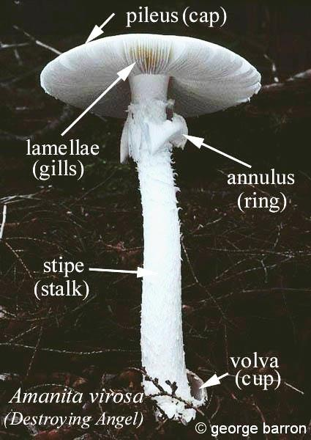
Destroying Angel (Amanita virosa, bisporigia, verna)
Pure white throughout
Cap 2-5” wide, curved like a parasol to flat; stipe 3-8”long, ¼-3/4 wide with a membranous white cup at base; annulus white, pendant.
A verna is mainly western, but occasional in east, the others are eastern.
White spore print
Fairly common in woods from late June to early November
Poisonous
Notes:
When young, looks a lot like an edible puffball.

Slide 16
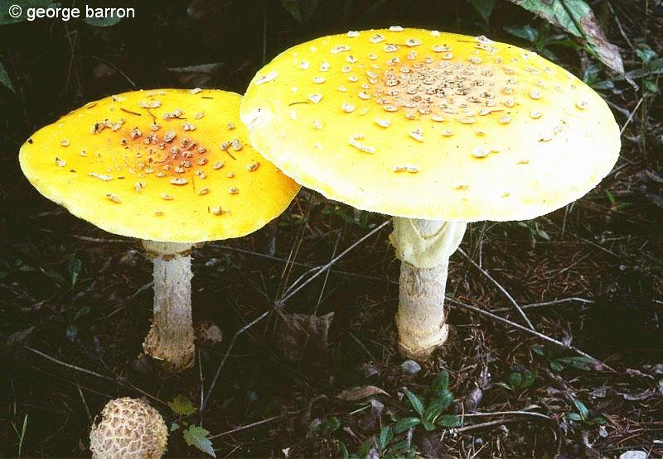
Fly Agaric (Amanita muscaria)
Pure white flesh throughout
Cap, red-orange to yellow-orange, 2-10 inches wide with white cottony patches scattered across, margin of cap with faint radial lines; gills, white, not attached to stipe; stipe 2-7 inches tall ¼-1 ½ in diameter with concentric rings of cottony tissue on the bulbous base; partial veil (annulus), white, pendant
White spore print
Common in late summer to fall on ground under pines or other conifers, may form fairy rings
Poisonous
Photo by: Richard Orr

Slide 17
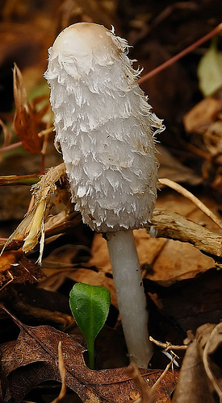
Shaggy Mane (Coprinus comatus)
Cap 2-6 inches in length; stalk 2.5-7 inches long
Oval to bluntly cylindrical with incurved margin at first, becoming somewhat bell-shaped
White to dingy white
Black spore print
Gregarious on the ground in grassy places (lawns, pastures, etc) and on hard-packed soil
Edible when young
Photo by: Richard Orr

Slide 18
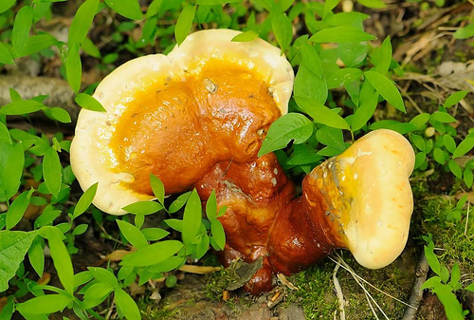
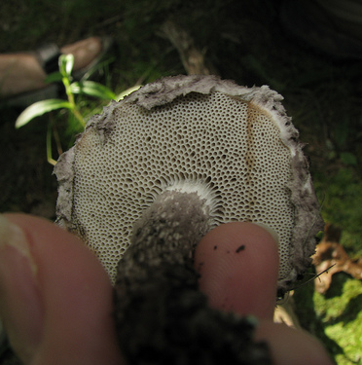
Boletes & Stalked Polyphores
All have pores under caps
Polyphores:
Generally shaped like shelves
Nearly all grow on wood, such as trees, logs, stumps, or buried wood
Boletes:
Grow on the ground near trees, not on wood
Layer of tubes that leads to the pores peels off from the rest of the cap easily
Old-Man-of-the-Woods by: Kerry Wixted

Slide 19
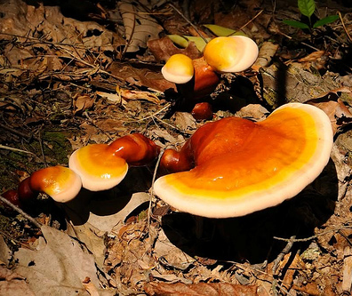
Ling Chi (Ganoderma tsugae)
Cap 3-12 inches in length; stalk 1.5-6 inches long
Cap nearly globose, soon expanding to spathulate, fan or kidney-shaped
Brownish orange to reddish brown with white to yellowish margin when young
Surface shiny
Rusty brown spore print
Solitary or in groups on standing dead or dying trunks, logs & stumps, especially hemlocks
Medicinal
Photos by: Richard Orr

Slide 20
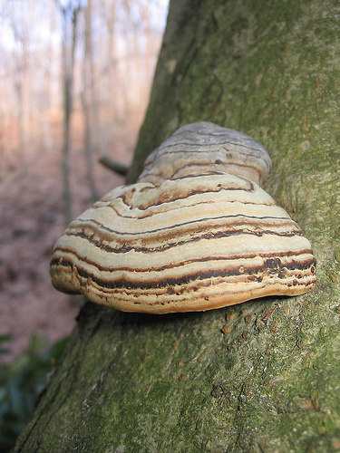
Bracket Fungi
Shelf or bracket-shaped
Some tree parasites
Important decomposers & recyclers
Mostly fibrous & woody or leathery
Tinder Fungus by: Kerry Wixted

Slide 21
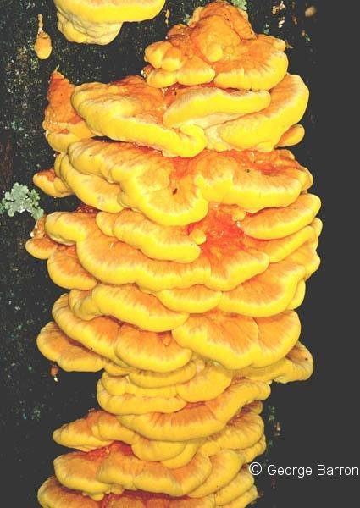
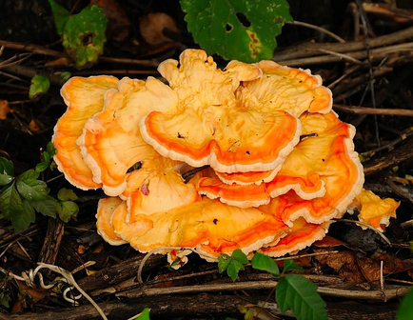
Sulphur Shelf (Laetiporus sulphureus)
Up to 12 inches wide
Annual
Semicircular to fan-shaped bracket with wavy margins
Bright orange when fresh, pale to whitish when old
White spore print
Solitary or compound growth on living or dead broad-leaved trees
Aka Chicken-of-the-Woods
Edible when young
Photo by: Richard Orr

Slide 22
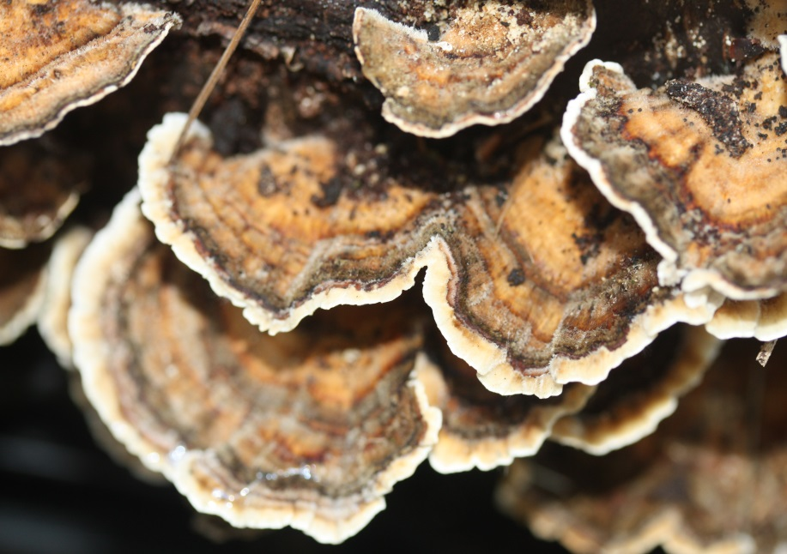
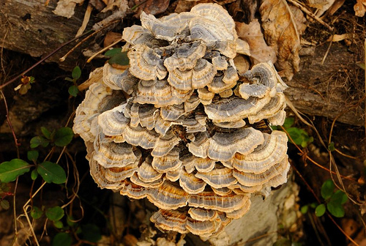
Turkey Tail (Trametes versicolor)
1-3 inches wide
Annual
Small, thin semicircular to fan-shaped bracket
Cream spore print
Grows in overlapping tiers on branches, logs & stumps of broad-leaved trees
Similar to False Turkey Tail (Stereum ostrea) but has a white undersurface with small pores
Not Edible, but Non-Poisonous
Photo by: Richard Orr

Slide 23
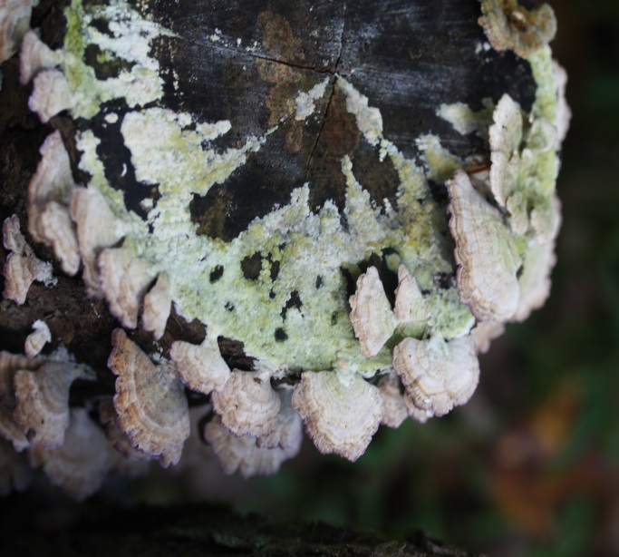
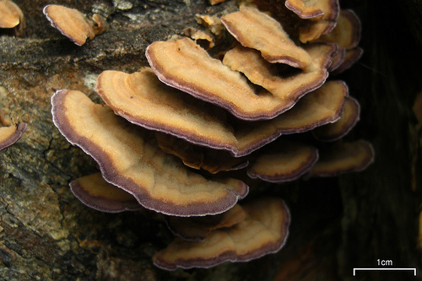
Violet Toothed Polyphore (Trichaptum biformis )
Tough, leathery, overlapping shelves,
White-grayish, hairy with purple edges and undersides
3/8 to 3” wide, with thin flesh
Underside is toothed
Found on dead trees and stumps; important for wood decomposition
Not edible
Photo by: Jason Hollinger, Flickr

Slide 24
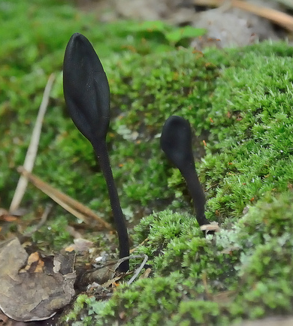
Club Fungi
Club-shaped or finger-like w/ simple stalks
Represent several taxonomic groups
Grow singly, clustered or scattered
Walter’s Earth Tongue by: Richard Orr

Slide 25
Elegant Stinkhorn (Mutinus elegans)
4-7 inches tall & spike shaped
Fertile surface= olive-brown slime layer (gleba)
Stinky!
Stalk cylindrical & hollow; arises from white “egg”
Typically in clusters on ground in rich woods, urban & landscaped areas
Edible in “egg” shape
Photo by: Richard Orr

Slide 26
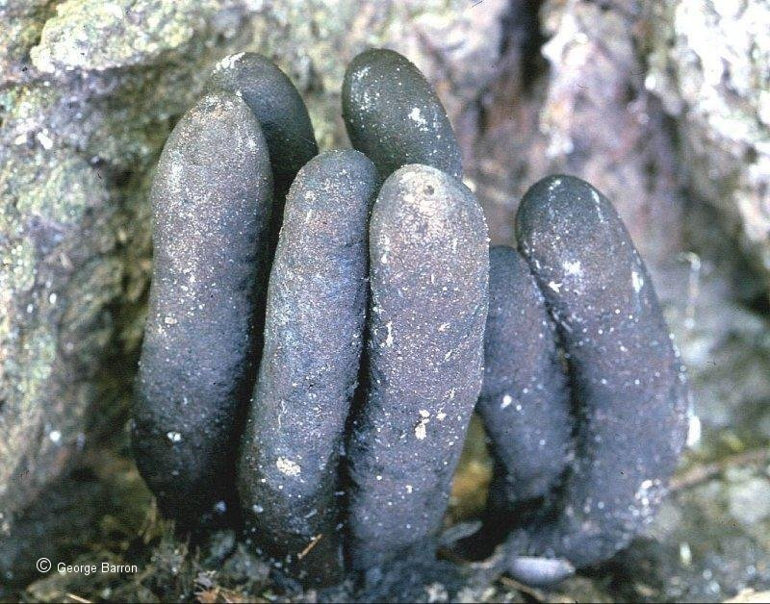
Dead Man’s Fingers (Xylaria polymorpha)
1-4 inches tall & up to 1.5 inches thick
Club-shaped, often gnarled or knobby
White to grayish and powdery at first, then black and minutely warty
Black spore print
Typically in clusters on decaying wood of broad-leaved trees, especially beech and maple
Not edible
Photo by: Kerry Wixted

Slide 27
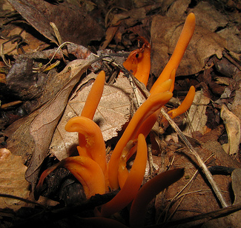
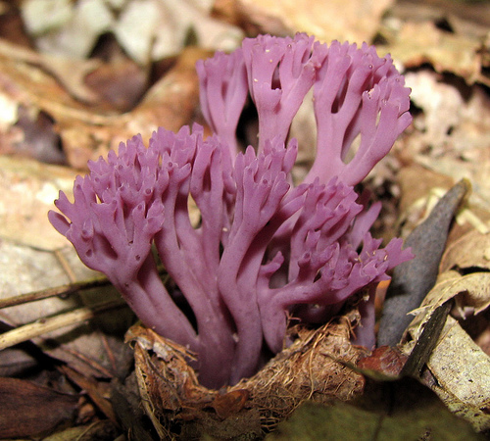
Coral Fungi & Lookalikes
Resemble marine corals
Grow as clusters of simple tubular clubs (worm corals) or branched & shrub-like
Often easily identified
Orange Spindle Coral
Photos by: Kerry Wixted

Slide 28
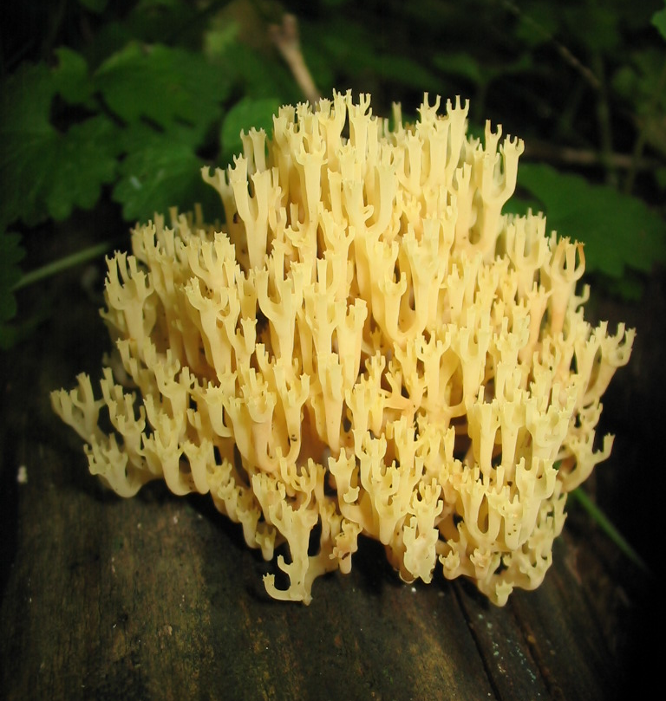
Crown-tipped Coral (Clavicorona pyxidata)
Many branched, pale yellowish coral-like fungus
Cup shaped crown-like tips; often growing from buried wood
Branches in equal three-sided groupings; ¾ - 2 3/8 “wide, 2-5” tall
Common in late spring to early summer
One of the few coral fungi growing on wood
Edible
Photo by: Kerry Wixted

Slide 29
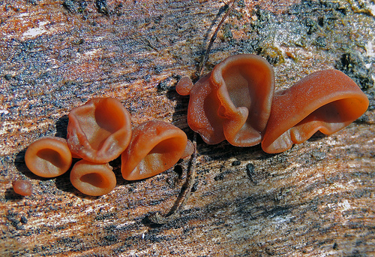
Jelly Fungi
Gelatinous to rubbery texture when moist
Have septate basidium (divided by partitions)
Often grow on logs, stumps and twigs
Some used for food in Chinese cuisine
Wood Ear by Bonnie Ott
Notes:
Septate basidium visible under microscope.

Slide 30
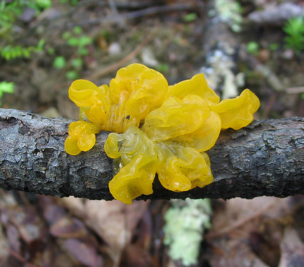
Witches Butter (Tremella mesenterica)
Yellow-orange gelatinous mass
Up to 4 inches across
Solitary or in clusters
Found on dead branches, stumps & logs spring-fall
Not edible
Photo by: Kerry Wixted

Slide 31
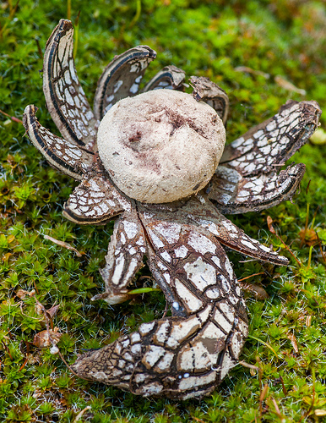
Puffballs, Earthstars & Lookalikes
Produce spores within enclosed outer wall (peridium) or spore case
Puffballs typically spherical to pear- shaped
Outer layer of earthstar peridium splits into ray-like segments
Earthstar by Hoarybat, Flickr

Slide 32
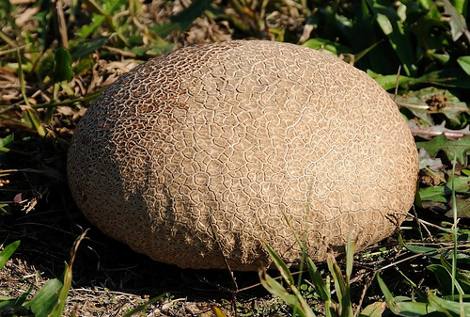
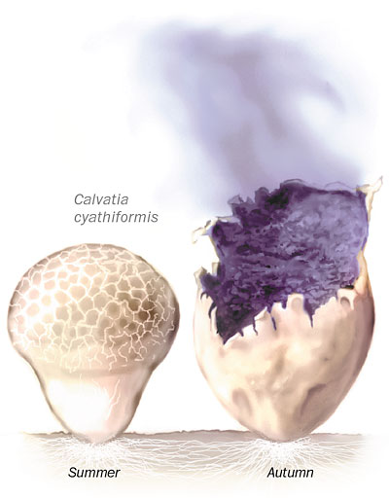
Purple-spored Puffball (Calvatia cynthiformis)
2.5-7 inches broad
Globose or pear-shaped
White-pale brown when young & dark brown when aged
Solitary or in groups
Open, grassy areas
Edible when young (& white inside)
Photos by: Richard Orr

Slide 33
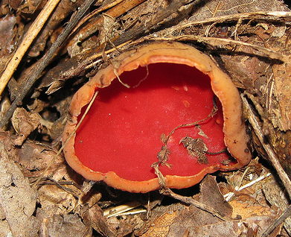
Cup Fungi & Bird’s Nest Fungi
Shaped more or less like cups, saucers, or goblets
To ID, examine:
Upper surface of the cup
Margin (looking for tiny hairs or pustules)
Undersurface (the sterile "excipular surface")
Stem or pseudo-stem
Flesh
Bird’s Nest not related to cup fungi
Scarlet Elf Cup by Kerry Wixted
Hairy Rubber Cup by Kerry Wixted

Slide 34
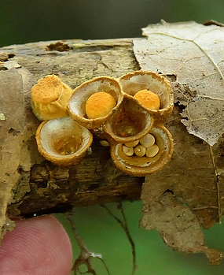
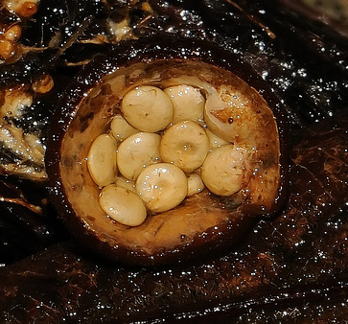
Bird’s Nest (Crucibulum laevis)
¼ - 3/8 inches high and wide
Barrel-shaped, tapering toward base, becoming cup-like at maturity when lid disintegrates to reveal numerous spore-bearing “eggs”
Typically in clusters on a variety of organic substrates such as twigs, compost, etc
Not edible
Photos by: Richard Orr

Slide 35
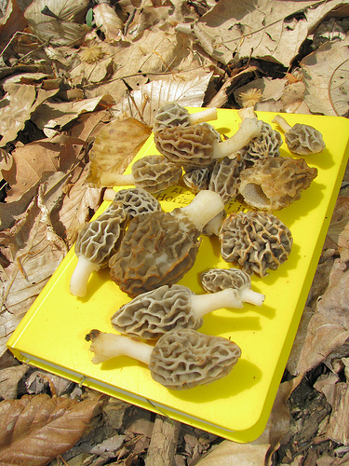
Morels, False Morels & Elfin Saddles
Group contains edible & poisonous mushrooms
Most species fruit from late March to early May
Photo by: Kerry Wixted

Slide 36
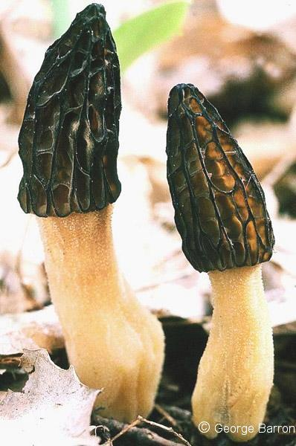
Black Morel (Morchella elata)
Up to 6 inches tall
Conical, pitted head on long stalk; head honeycombed with dark brown pits
Usually gregarious on ground in woods near trees in more open areas
Similar to Common Morel (Morchella esculenta) which is tan to yellow-brown
Edible when cooked

Slide 37
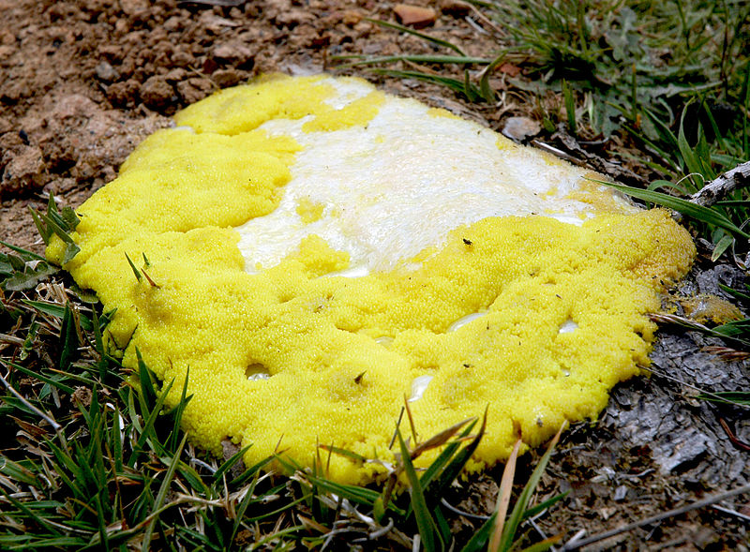
Formerly Known as Fungi: Slimemolds
Now Protists
Lack chitin
Multinucleate mass of protoplasm (called a plasmodium)
Produce spores
Moves like an amoeba
Dog Vomit (aka Scrambled Egg) Slime mold by KeresH, Wikimedia Commons

Slide 38
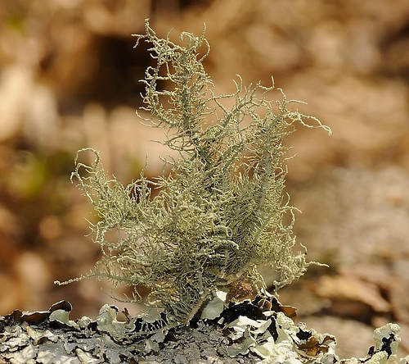
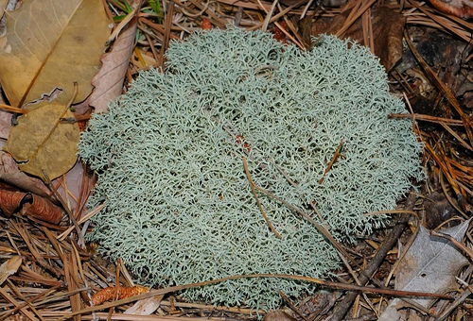
Lichens
Association between a fungus and an alga or cyanobacterium (blue-green alga)
Under a microscope, the association is seen to consist of millions of cells of algae (called the phycobiont) woven into a matrix formed of the filaments of the fungus (called the mycobiont)
Beard Lichen by Richard Orr
Reindeer Moss (a lichen) by Richard Orr

Slide 39
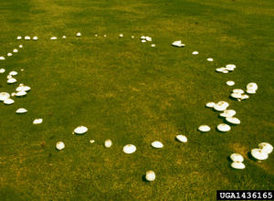
Fungal Fairy Rings
Soil-inhabiting Basidiomycetes
~50 species
Marasmius oreades, Agaricus campestris, Lycoperdon spp.,and Scleroderma spp= most common.
Breakdown organic matter in soil; often associated w/ tree roots
USDA

Slide 40
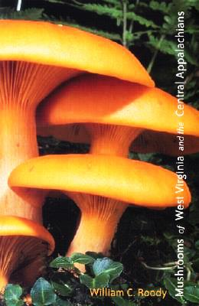
Mushroom Guides
Mushrooms of WV & Central Appalachians by William C. Roody
Audubon Field Guide to North American Mushrooms by Gary H. Lincoff and Alfred A. Knopf
Mushrooms of Northeast North America by George Barron
Field Guide to Wild Mushrooms of PA and the Mid-Atlantic by Bill Russell
Mushrooms of Northeastern North America by Alan Bessette et al
Mushrooms Demystified by David Aurora

Slide 41
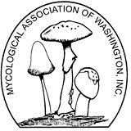
Mushroom Websites
Tom Volk’s Fungi Page
MycoLog
Tree of Life: Fungi
Wayne’s World: Fungi
Fungi Magazine
Fungi Online
Mycological Association of Washington DC

